Slide 1


GROUP 14
CSE 6363-002 MACHINE LEARNING
PEOPLE AND CAR DETECTION FOR AUTONOMOUS VEHICLES
INSRUCTOR
Dr. Jesus A.Gonzalez
PRESENTED BY
Vyash Natarajan --1002060598 Jeeva Manavalan - 1002067528 Shibani Prasath - 1002060600 Sakshi Shinde - 1002066314

Slide 2
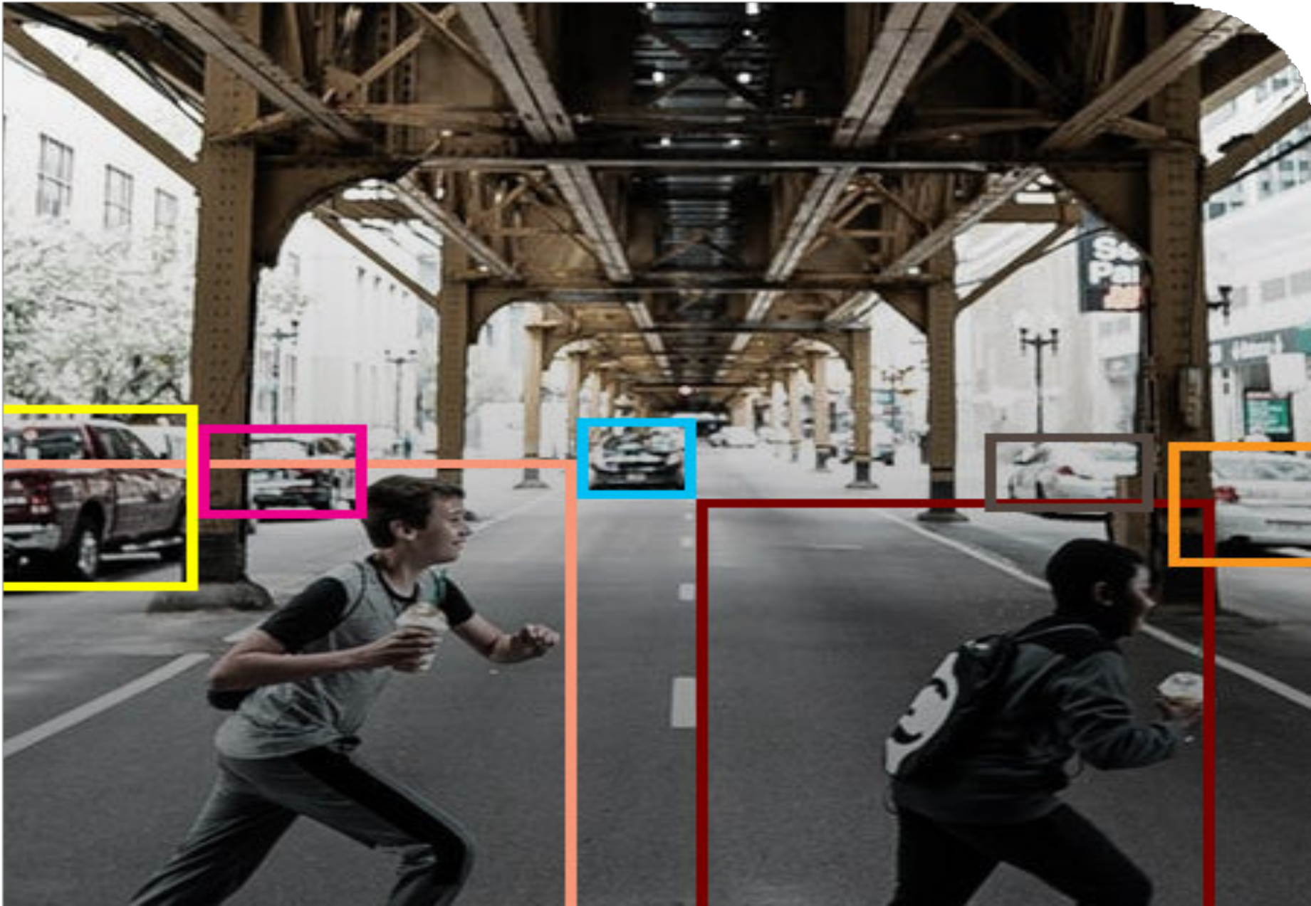

Project Title
GROUP 14
People and Car Detection for Autonomous Vehicle (Computer Vision with Deep Learning)
Object detection on images or real time object detection on video

Slide 3

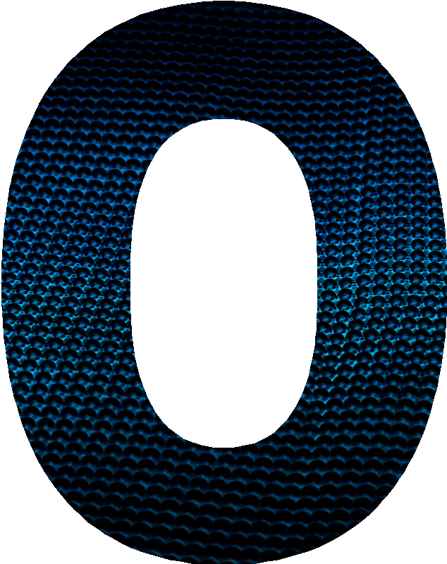
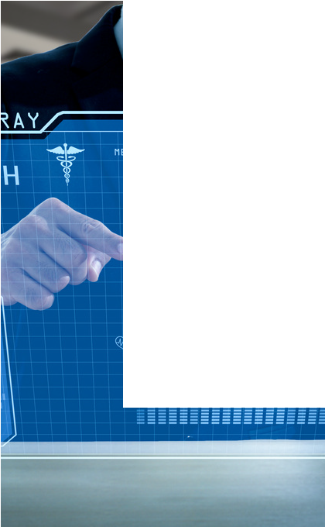


Introduction
GROUP 14
The You Only Look Once (YOLO) algorithm has emerged as a very effective and precise method for recognizing objects in real-time among other object identification algorithms. The YOLO algorithm's use in people and car detection, which is essential in a number of fields, including traffic control, surveillance, and security, is one of its most promising applications. In this study, we investigate the YOLO algorithm's implementation for people and vehicle recognition and assess its performance on Coco dataset.

Slide 4


Dataset Description
GROUP 14
Coco Dataset
The Common Objects in Context (COCO) dataset is a widely used dataset for object detection tasks, with a substantial and diverse collection of annotated images that can be used to train and test object detection algorithms.
Udacity Self Driving Car Dataset
The Udacity Self-Driving Car Dataset is a high-quality dataset with annotations provided by human experts, containing diverse images captured from different angles and distances, suitable for testing object detection algorithms' effectiveness.

Slide 5
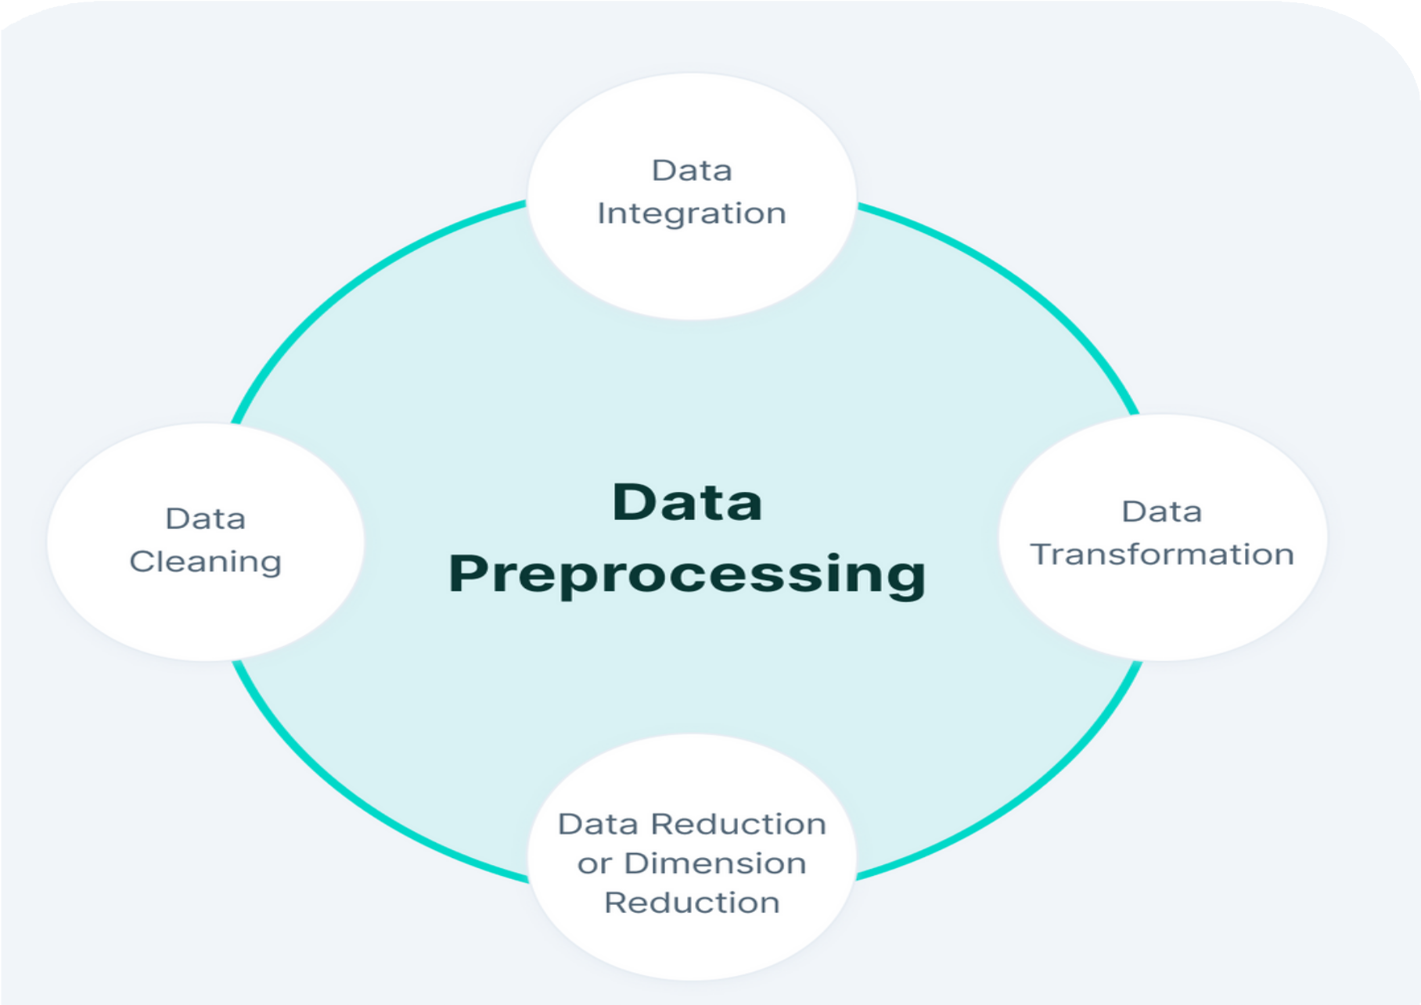
Data Preprocessing
GROUP 14
Data Cleaning: The code ensures the dataset is free of errors and inconsistencies by checking for and removing any corrupt or invalid files. It also properly formats the data for use in the object detection model.
Data Transformation: The code transforms the dataset by sorting the images into different sets based on their classification. This allows for proper training, validation, and testing of the object detection model.
Data Integration: The code integrates the data by merging the images with their corresponding label files and placing them into their designated directories. This allows for easy access and organization of the data for training the object detection model.
Data Reduction: The code reduces the dataset by selecting a portion of the images for training, validation, and testing. This allows for more efficient use of computing resources and a quicker training process for the object detection model.

Slide 6
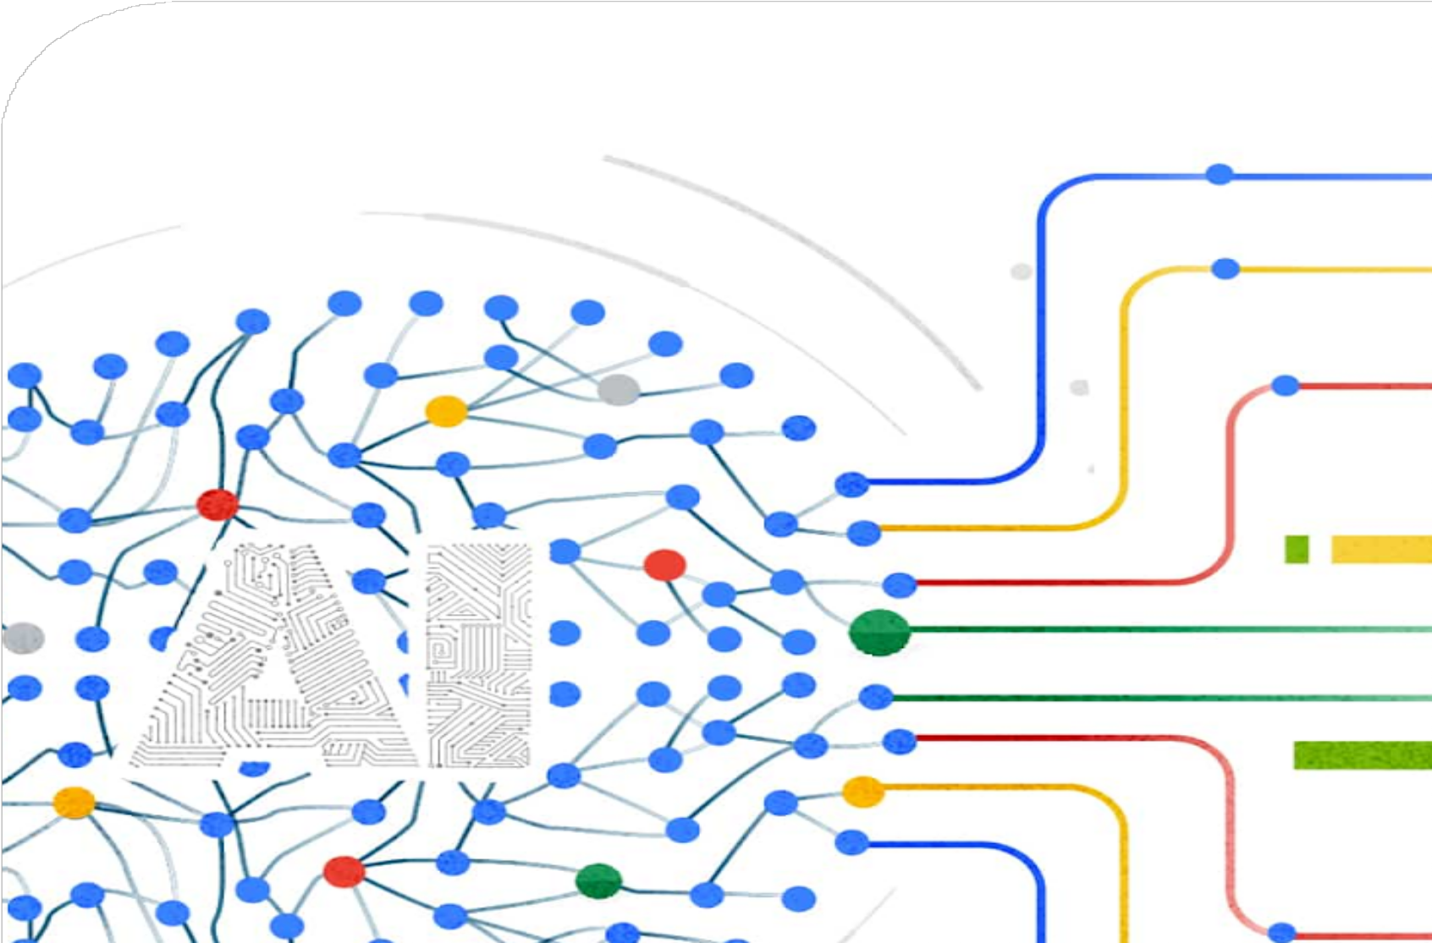

Model Training
GROUP 14
The model training process using YOLOv5 involves the following steps: preprocessing and organizing the data into separate sets for training, validation, and testing; selecting and configuring the YOLOv5 architecture for the specific object detection task; training the model using the training set and evaluating its performance using the validation set; testing the trained model using the test set; and using the trained model for inference on new images to detect objects in real-world scenarios.

Slide 7

YOLO architecture
GROUP 14
YOLOv5 is an advanced object detection algorithm used for identifying and locating objects within images or video frames. It is an improved version of YOLOv4 and is highly accurate and fast. YOLOv5 uses a single neural network to predict bounding boxes and class probabilities for objects in an image by dividing it into a grid of cells and applying convolutional filters to each cell. This results in real-time object detection and tracking and high accuracy detection of small objects. YOLOv5 is lightweight, allowing for fast inference speeds even on low-end hardware, and can be customized for specific use cases such as detecting faces or vehicles. Overall, YOLOv5 is widely used in various applications, including autonomous vehicles, security systems, and robotics.

Slide 8

Modify YOLO architecture
GROUP 14
To modify the YOLO architecture by freezing layers and training only the last layer, we would start by loading pre-trained weights for all layers except the last one. The lower layers of a neural network learn general features while the higher layers learn specialized features. By freezing the weights of the pre-trained layers, we can extract general features from the input while training a new layer to learn specific features for the problem at hand. Only the weights of the new layer would be updated during training, while the pre-trained layers would remain fixed. This modification can be useful when working with limited training data, as it allows us to leverage the knowledge learned by pre-trained layers while still fine-tuning the network for the specific problem. It's important to note that there are many other ways to modify and customize the YOLO architecture based on specific requirements.

Slide 9
Train the Model
GROUP 14
YoloV5 is a deep learning model used for object detection tasks. It is an improved version of the Yolo algorithm that uses convolutional neural networks (CNNs) to detect objects in an image and predict their classes and locations. The model has been pre-trained on a large dataset and can be fine-tuned on a smaller dataset to detect specific objects. To train the YoloV5 model, one needs to specify the training data, the number of epochs, and the batch size, and then run the training script.
Evaluate the Model
The evaluation process of YOLOv5 model involves running the model on a set of test data to measure its performance metrics, including precision, recall, and mAP. The test data should be representative of the real-world scenarios the model is intended to work on. The results of the evaluation can be visualized using various tools, such as confusion matrix and precision-recall curves. The evaluation metrics can help assess the strengths and weaknesses of the model and guide further improvements in its design and training.

Slide 10
Tune the Model
GROUP 14
Automated training: The provided code automates the training process, saving users time and effort by executing a training script with specific hyperparameters. This feature is useful as it reduces the need to manually run the script for each training session.
Hyperparameter flexibility: The code allows users to specify various hyperparameters, including the number of epochs, batch size, and model weights. This feature provides flexibility for experimenting with different settings to find the best configuration for the specific use case.
Use of pre-trained weights: The code uses pre-trained weights for the YOLOv5 model, providing a good initialization point that can improve the model's performance. Using pre-trained weights also saves time and resources, as there is no need to train the model from scratch.
YAML data file support: The code supports YAML data files, making it easier to manage training data and settings. YAML files are easier to read and edit than other file formats such as JSON, which can help streamline the data management process.
Layer freezing: The code freezes specific layers of the model during training, which can prevent overfitting and improve the model's ability to generalize. Freezing layers can also speed up training by not updating certain weights during backpropagation.

Slide 11
This code initializes a variable RES_DIR to set the output directory for the training results. The set_res_dir() function is likely used to create a directory based on a specific naming convention or timestamp.
If TRAIN is set to True, the code executes a system command by using the exclamation mark syntax in Python to run a command-line interface for training the YOLOv5 object detection model.
The command uses various arguments to specify the training data location, the pre-trained weights file to use as a starting point, image size, number of epochs, batch size, and other options.
The --freeze argument specifies the layers to freeze during training. In this case, the argument lists the indices of the layers to freeze, which are the first 15 layers (0 to 14) of the YOLOv5 model. This means that only the last few layers of the network will be trained, while the earlier layers will retain their pre-trained weights.
The training results will be saved in the directory specified by RES_DIR, which was initialized earlier in the code.
RES_DIR = set_res_dir()
if TRAIN:
!python train.py --data ../data.yaml --weights yolov5m.pt \
--img 640 --epochs {EPOCHS} --batch-size 16 --name {RES_DIR} \
--freeze 0 1 2 3 4 5 6 7 8 9 10 11 12 13 14

Slide 12
OVERVIEW
IMPORT LIBRARIES
This step involves importing the necessary software libraries that contain pre-built functions to be used in the subsequent code.
LOAD AND PREPROCESS
TRAIN AND EVALUATE
ANALYSIS
HELPER FUNTION
This step involves defining helper functions that are not already available in the imported libraries, which are needed to perform specific tasks.
This step involves loading and preprocessing the data used for training, validation, or testing the machine learning model.
This step involves training the machine learning model on the preprocessed data and evaluating its performance using various metrics.
This step involves analyzing the performance of the machine learning model and identifying areas for improvement.

Slide 13
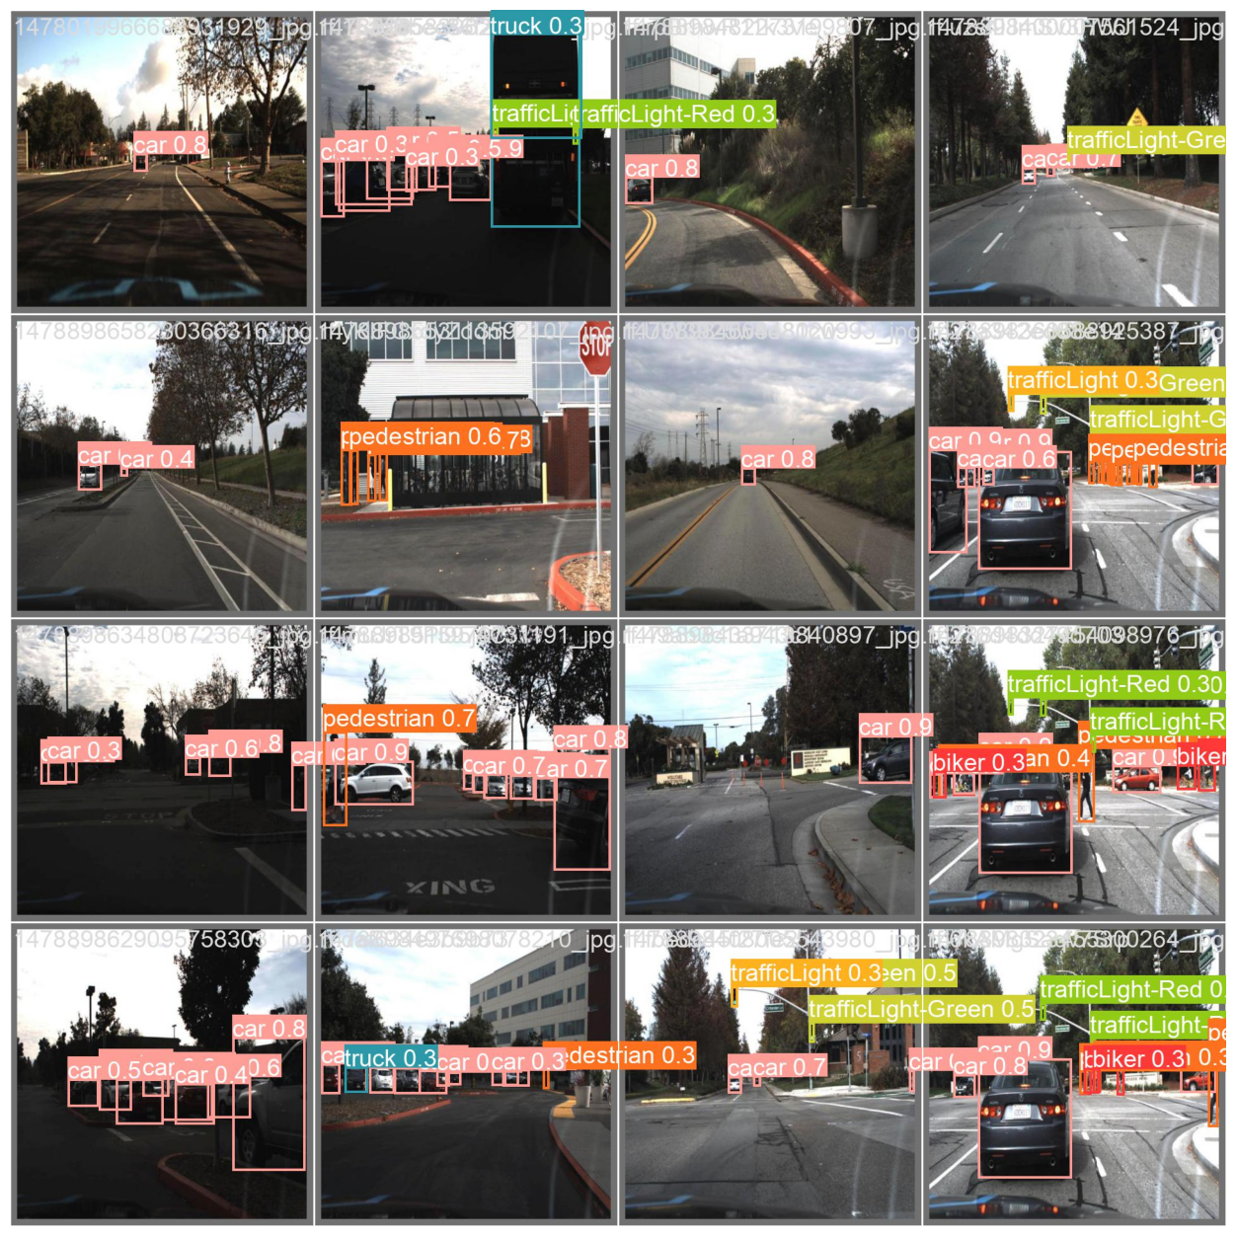
RESULT

Slide 14
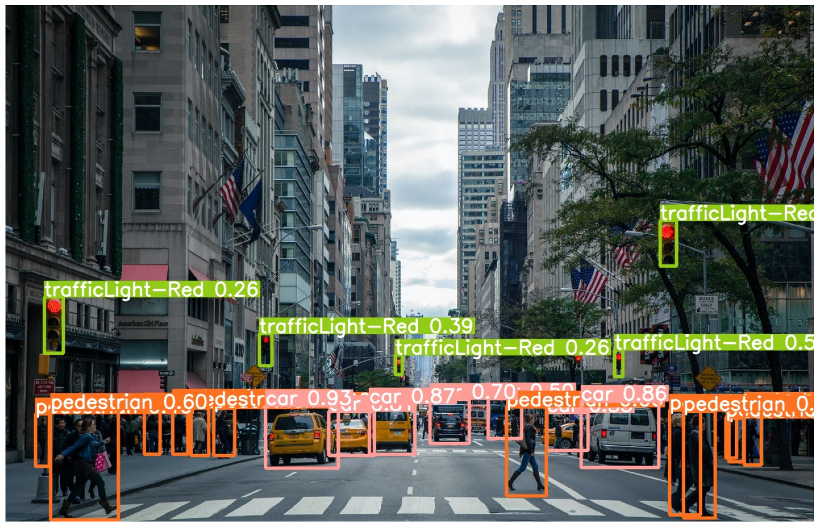
PREDICTION

Slide 15
 | YOLOv3 | YOLOv5
Architecture | 8 conv layers with batch normalization and LeakyReLU | Lightweight model architecture
Output | Bounding boxes, confidence scores, and class probabilities for a specific number of object classes | Bounding boxes, confidence scores, and class probabilities for a specific number of object classes
Training | Binary cross-entropy loss and the Adam optimizer with a learning rate of 0.001 | Pre-trained weights and fine-tuning with frozen layers and modified last layer
Performance | Robust and suitable for various applications | Efficient and suitable for real-time object detection tasks with limited computational resources
In summary, YOLOv3 has a traditional and robust architecture and is suitable for various applications, while YOLOv5 has a lightweight architecture and is efficient for real-time object detection tasks with limited computational resources. The choice of algorithm depends on the specific requirements of the object detection task at hand.

Slide 16
CITATION
Roboflow. (2022, August 8). Udacity Self driving car object detection dataset. Roboflow. Retrieved April 29, 2023, from https://public.roboflow.com/object-detection/self-driving-car
Revolutionizing the world of Vision Ai. Ultralytics. (n.d.). Retrieved April 29, 2023, from https://ultralytics.com/yolov5
REFERENCE
Parsing YAML with Scala" by Odersky et al. (2017) - This paper describes an implementation of a YAML parser in the Scala programming language, which can be used to process YAML documents in a type-safe and efficient manner.
"You Only Look Once: Unified, Real-Time Object Detection" by J. Redmon et al.,
2016 - This paper introduces YOLO, a real-time object detection system that is
based on a single convolutional neural network."YOLOv5: A Universal Object Detection Framework" by Glenn Jocher et al. (2020) - This is the original paper that introduced YOLOv5. It describes the architecture of the algorithm, as well as its performance on several benchmarks.
"Improved Object Detection with YOLOv5 and Label Smoothing" by Michael Danielczuk et al. (2021) - This paper describes a modification to YOLOv5 that incorporates label smoothing, which improves the accuracy of the algorithm on small objects.

